Slide 1
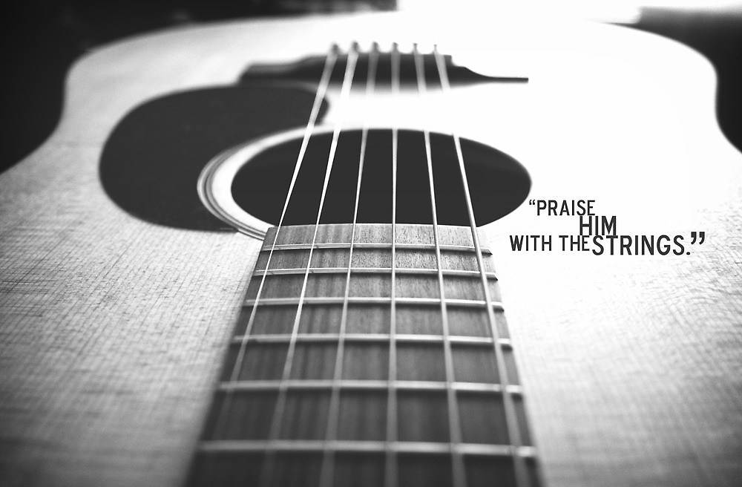

Slide 2
GUITAR 101 The BEGINNER COURSE : week 1

Slide 3
INTRODUCTION
BEGINNER PLAYERS
Knows only a few chords – or does not know any at all
Can not play a song
INTERMEDIATE PLAYERS
Knows most of the chords and chord progressions
Knows a number of strumming combinations
Knows at least 1 scale
Can transcribe a song

Slide 4
Sub – group for beginner class
Instrument | Guitar |  |  |  | Bass
Mentor | Jeff | Jethro | JR | PTEarl | Grej
 | Evan | Esa | Janice | Francis | Bong
 | RJ | Rollie | PTVin | Mark | Rey

Slide 5
today’s activity : the basics
ROLES OF GUITAR PLAYERS
GUITAR PARTS
LETTER NOTATION
TUNING
FRETBOARD NOTES
BASIC STRUMMING: 4 COUNTS AND 2 COUNTS
YOUR FIRST CHORDS: C A G E D
YOUR FIRST SONG: LORD I LIFT YOUR NAME ON HIGH

Slide 6
Part 1 : basic theory

Slide 7
Letter notation
System of representing a set of pitches by letters
C – D – E – F – G – A – B
do – re – mi – fa – so – la – ti – do (diatonic scale)
Advantage : Easy to remember / memorize
Chords (combination of notes) are also represented by these letters

Slide 8
Diatonic scale
The most common scale in modern music
Scale is a set of notes played to create melodies and harmonies.
It has intervals in between, this intervals determine the difference between scales hence the difference between music melodies (western and eastern music).
Diatonic Scale (mostly used in western music)
DO – RE – MI – FA –SO – LA – TI – DO

Slide 9
Diatonic scale interval
C – D – E – F – G – A – B - C
1
note
1
note
0
note
1
note
1
note
1
note
0
note
C# or
Db
D#
or
Eb
none
F#
or
Gb
G#
or
Ab
A#
or
Bb
none
There are 12 notes from low C to high C

Slide 10
Diatonic scale – the most basic scale
Scale is a set of notes / pitches ordered from low to high
Diatonic scale is the most common scale
do – re – mi – fa – so – la – ti – do
Most songs that we play are based on this scale

Slide 12
Types and role of guitar players

Slide 13
Part 2 : guitar basics

Slide 14
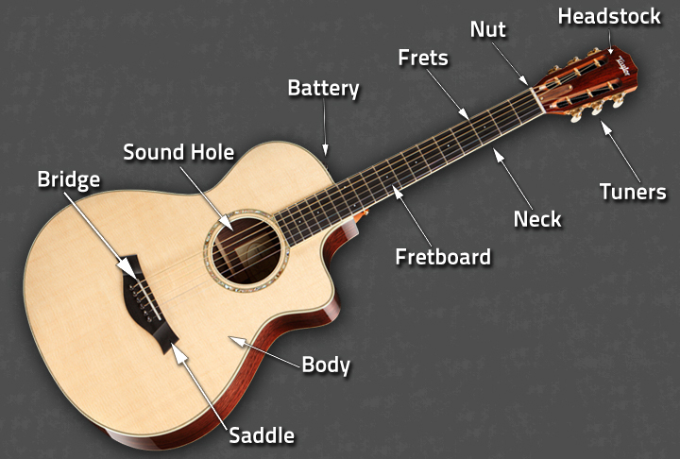
Guitar parts: acoustic

Slide 15
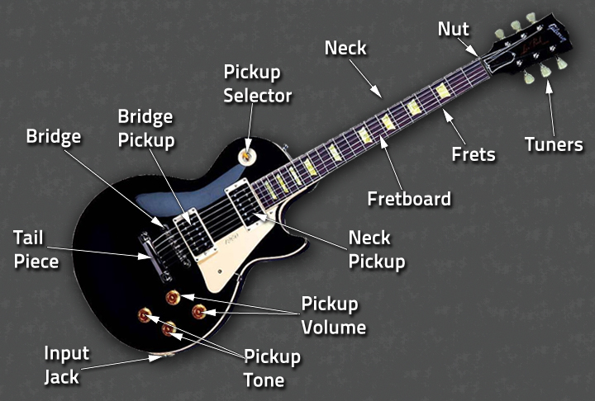
Guitar parts: electric

Slide 16
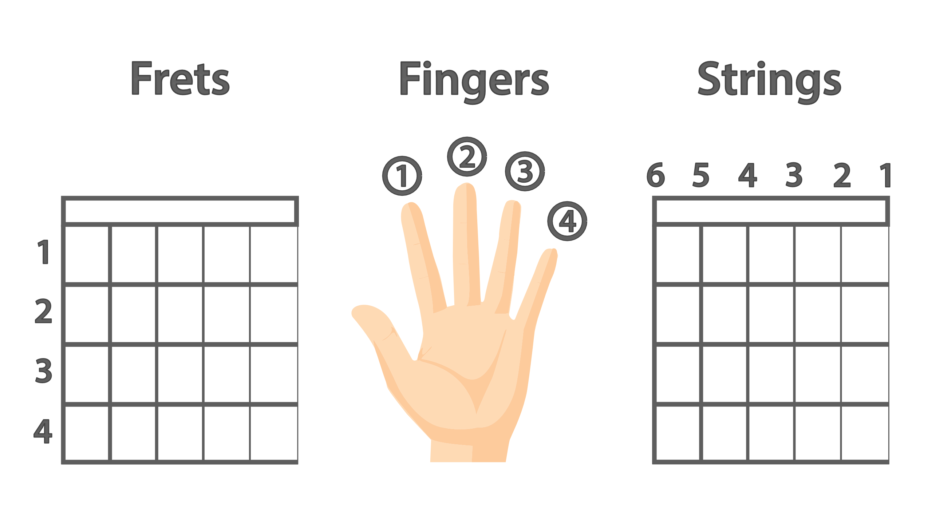
Fret, finger & string number notation

Slide 17
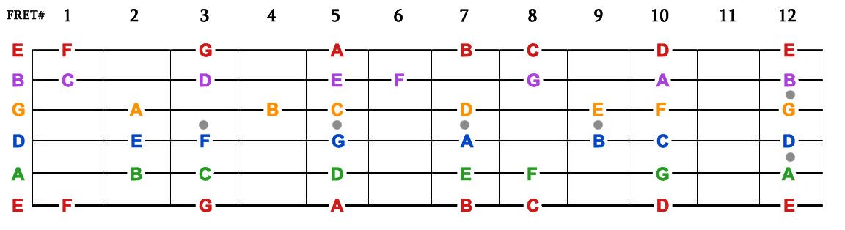
FRETBOARD NOTES
Exercise 1 : Identify the notes in the fret board
Exercise 2 : Play the diatonic scale

Slide 18
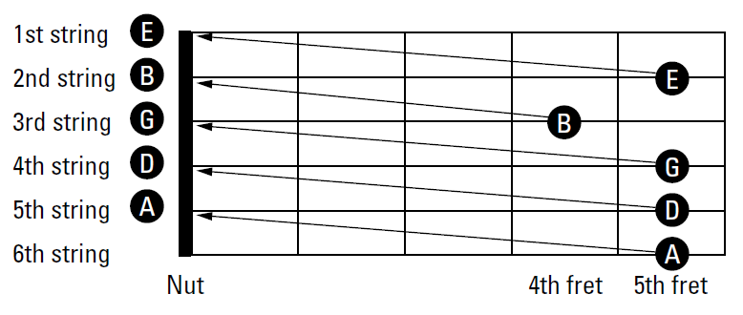
STANDARD tuning
E

Slide 19
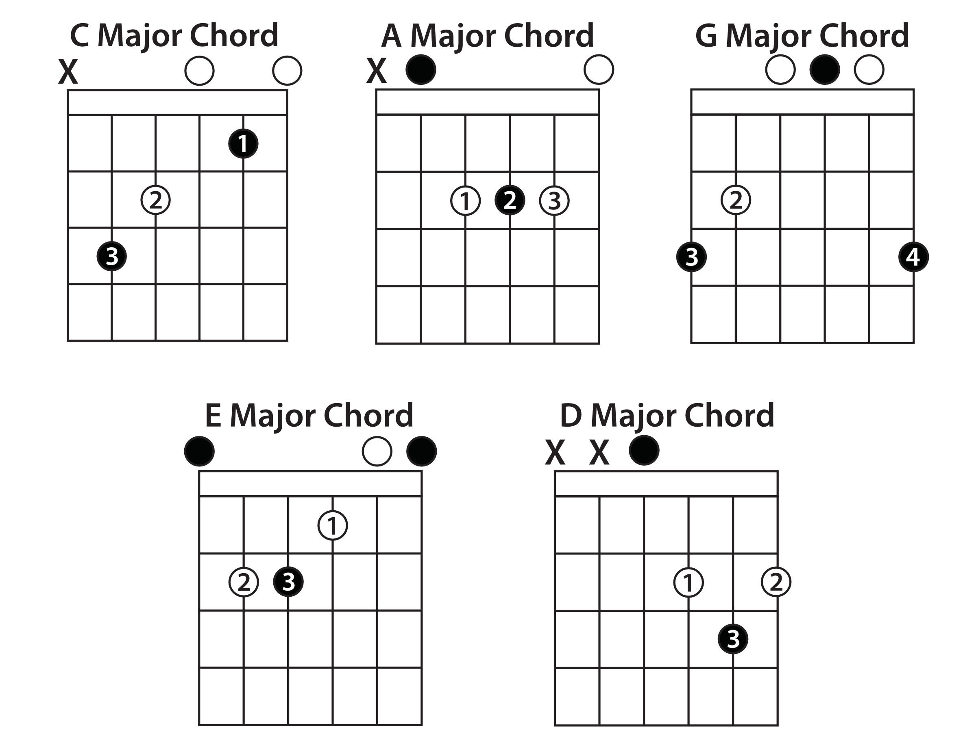
Your first chords : CAGED

Slide 20
Basic strumming
4/4 beat – most basic beat in music
4 counts down strumming
Best accompanied with foot tapping
To get locked-in with the rhythm

